Slide 1

CSD 3102- ARTIFICIAL INTELLIGENCE TECHNIQUES
MODULE 5
EXPERT SYSTEM

Slide 2
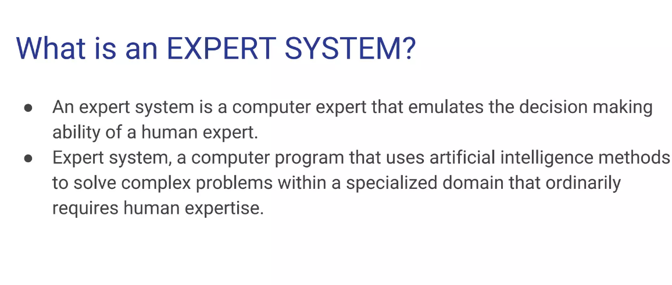

Slide 3


Slide 4
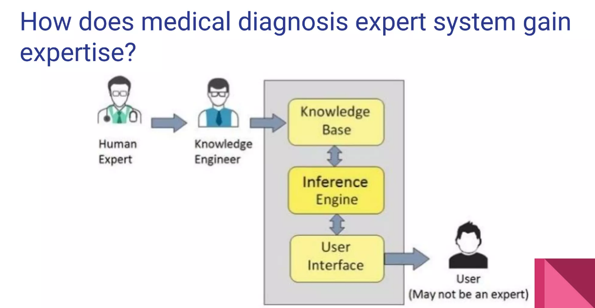

Slide 5
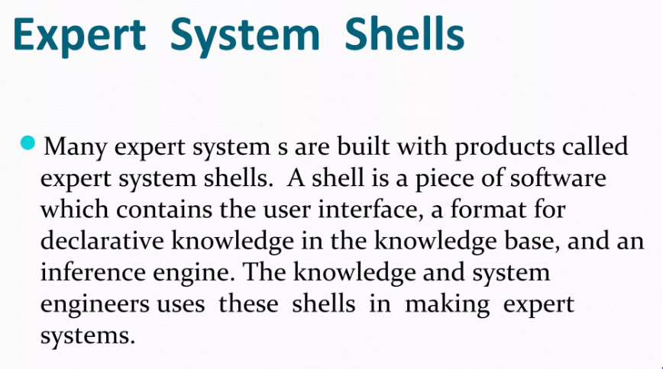

Slide 6
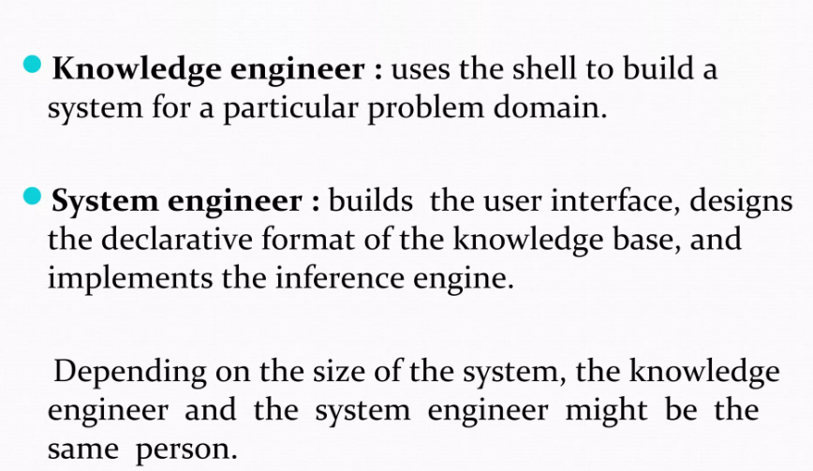

Slide 7
Components of expert system
Knowledge base – a set of rules as representation of the expertise, mostly in IF THEN statements.
Working storage – the data which is specific to a problem being solved.
Inference engine – the code at the core of the system which derives recommendations from the knowledge base and problem-specific data in working storage.
User interface – the code that controls the dialog between the user and the system.

Slide 8
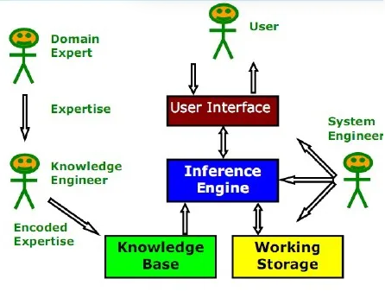
Architecture of Expert System

Slide 9
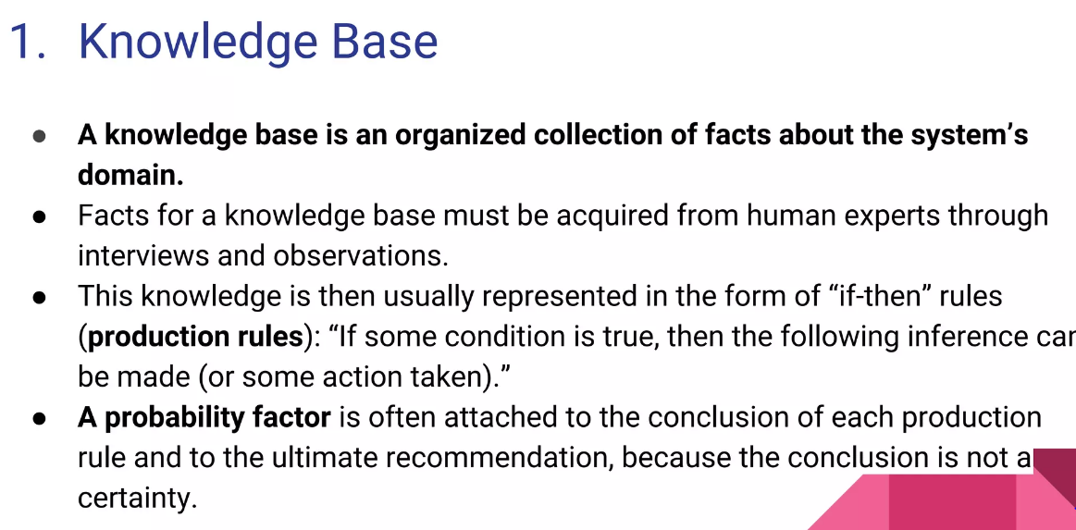

Slide 10
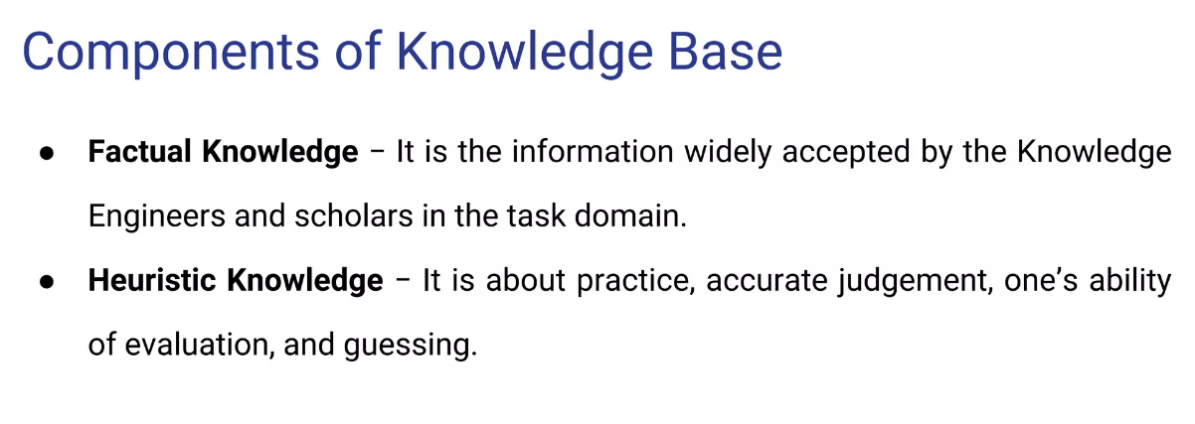

Slide 11
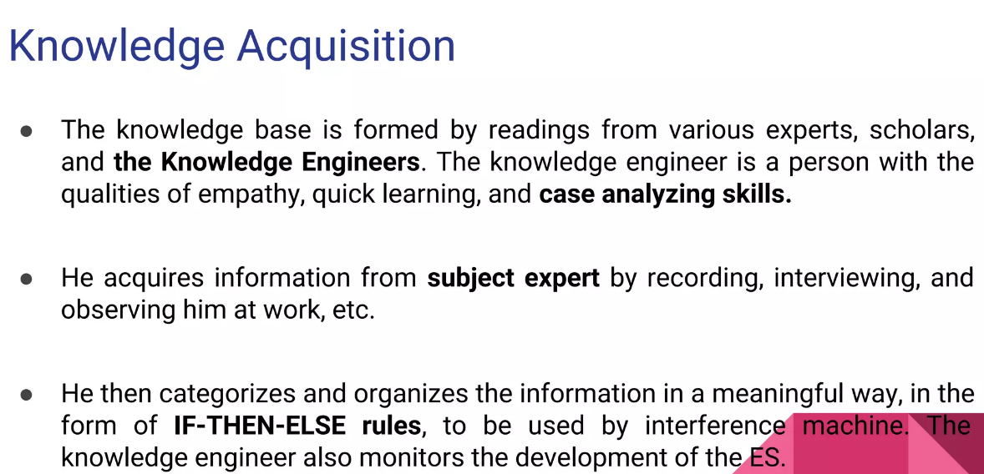

Slide 12
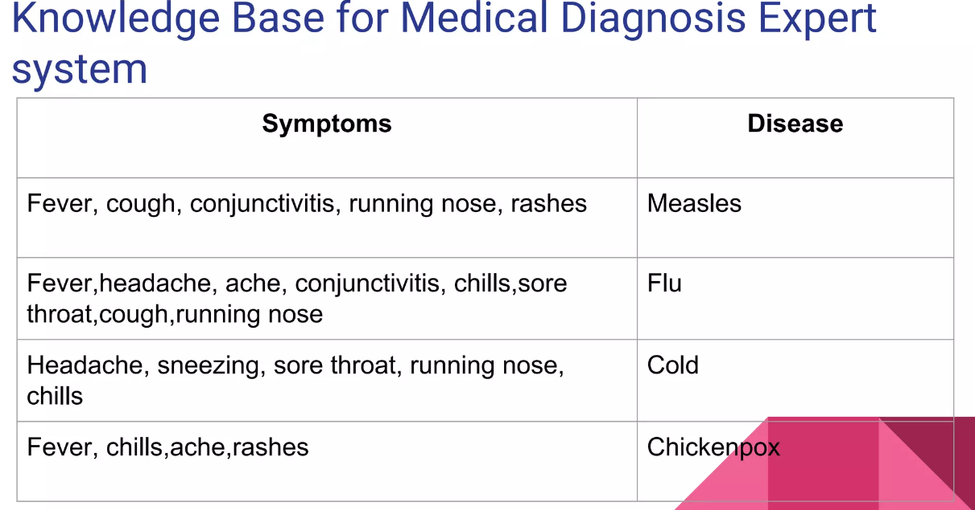

Slide 13
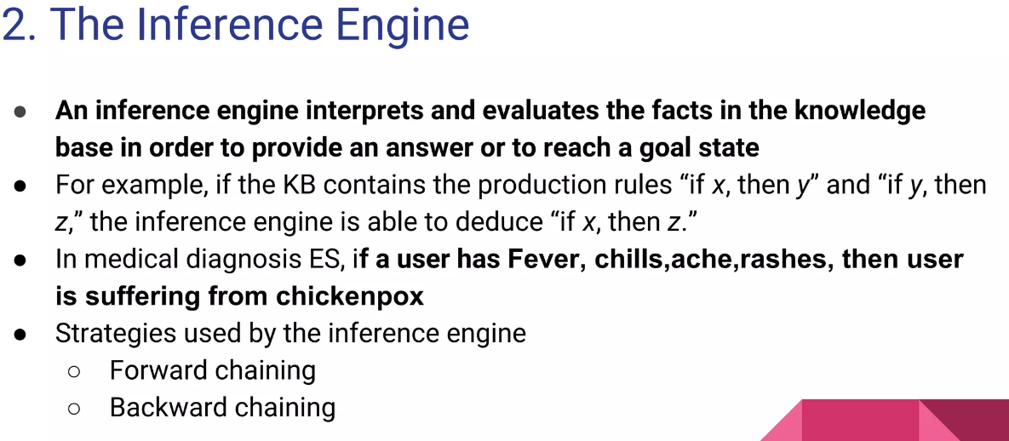

Slide 14
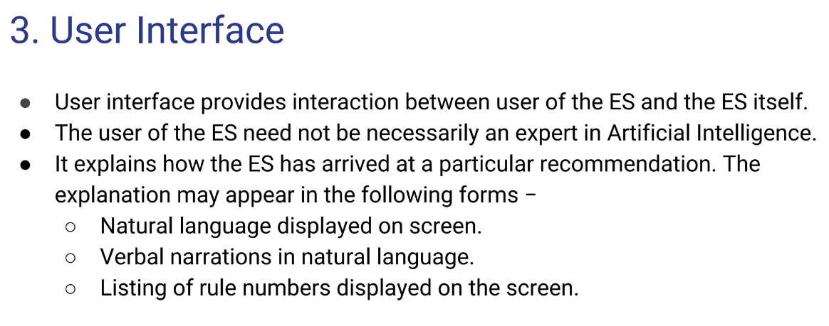

Slide 15
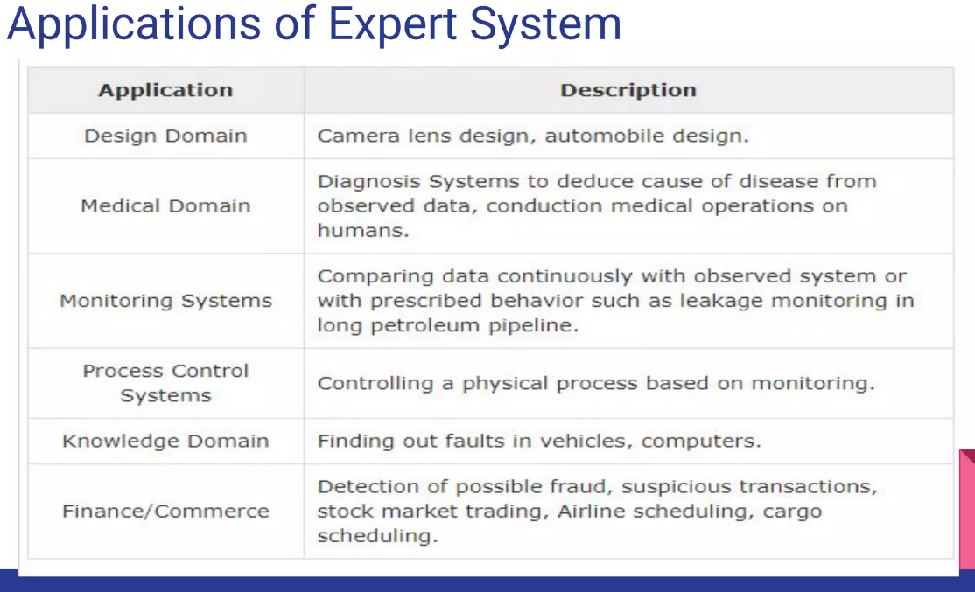

Slide 16
